Slide 1
Hibernate Queries

Slide 2
HQL
Hibernate Query Language is the object-oriented query language of the Hibernate Framework.
HQL is very similar to SQL except that we query against persistent objects instead of tables and columns.
Hibernate then translates the HQL queries to SQL queries and performs the action on the database.
In hibernate, we can directly write SQL statements using Native SQL, but using HQL or JPQL is recommended.
From the developer's perspective, this separates the application layer from the persistence layer and abstracts away the actual database interaction, promoting flexibility and reusability.

Slide 3
HQL
HQL is case-sensitive for properties like table and column names and not for keywords like SELECT, FROM, etc.
Advantages of HQL:
It supports OOP concepts like polymorphism, inheritance, and abstraction.
It is database-independent and easy to learn.

Slide 4


HQL Example
HQL Select Query example to retrieve a student details whose id is 101.
HQL Update Query example to update the name to "John" whose id is 105.
HQL Delete Query example to delete a student whose id is 108.

Slide 5
Criteria API
Hibernate Criteria API provides an object oriented approach for querying a database and getting results.
In hibernate, we can pull the data from the database using session methods; HQL, JPQL, Native SQL, or the Criteria API.
Hibernate Criteria are a programmatic and typesafe way to fetch data from the relational database.
In other words, criteria use explicit methods and return types to fetch data, rather than requiring you to write queries as Strings that might contain typos, and can't be easily parsed to determine what the resulting type of data will be.

Slide 6
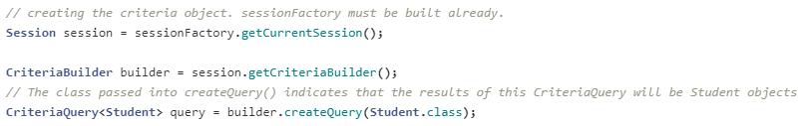
Criteria API
The javax.persistence.criteria.CriteriaQuery interface provides many methods to specify criteria and the object obtained by calling the createCriteria(Class<T>) method of a javax.persistence.criteria.CriteriaBuilder.
To create a Criteria object, we pass the persistent class or its entity name to the createCriteria(Class<T>) method, which in turn returns the instances of the persistent class.

Slide 7
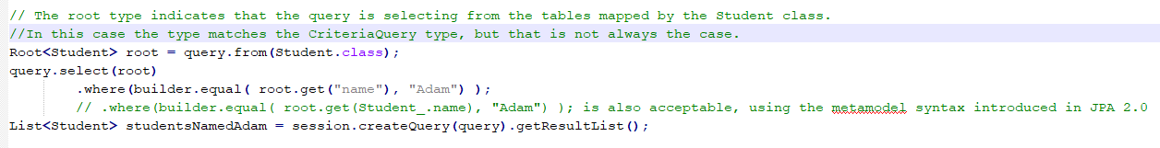
Criteria API
The CriteriaQuery interface makes it easy to selectively fetch the data based on conditions in the select query.
The JPA CriteriaBuilder class provides several methods that return Expression objects, which can used as conditions.

Slide 8
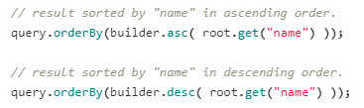
Criteria API
The CriteriaQuery interface provides the orderBy method to sort the result set in either ascending or descending order, accordings to expressions generated by the CriteriaBuilder.

Slide 9
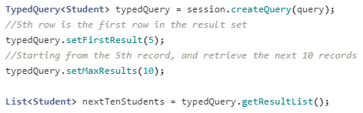
Criteria API
The Criteria API supports pagination.

Slide 10
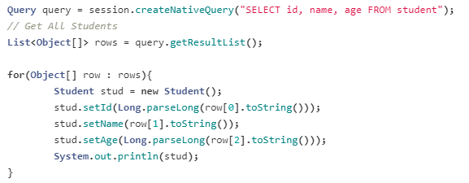
Hibernate NativeSQL
Hibernate provides the option to execute native SQL queries through the use of the SQLQuery object.
The Session.createNativeQuery(String query) method is used to create the NativeQuery object and execute it.
The getResultList() method returns a List of Object arrays, which we need to explicitly parse to double, long etc.
Hibernate will use ResultSetMetadata to deduce the actual order and types of the returned scalar values.

Slide 11
Hibernate NativeSQL
The addEntity() method used to get entity objects from a Native SQL query.
Alternatively, this can be provided as an argument to the overloaded method
The addJoin() method used to fetch the data from associated table using tables join.

Slide 12
Named Queries
In Hibernate, a Named Query is a SQL expression with a predefined unchangeable query string. We can define a named query either in the hibernate mapping file or in an entity class.
Annotations used in an entity class:
@NamedQueries - used to define the multiple HQL expressions.
@NamedQuery - used to define the single HQL expression.
@NamedNativeQueries - used to define the multiple native SQL expressions.
@NamedNativeQuery - used to define the single native SQL expression.
@NamedQuery has two attributes:
name - used to specify a name by which a session object can locate the query.
query - used to specify the HQL statments.

Slide 13
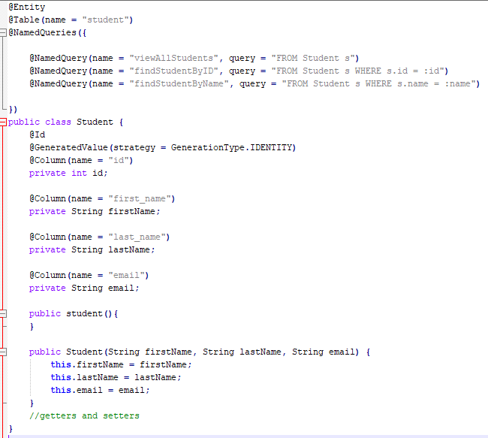
Named Queries

Slide 14
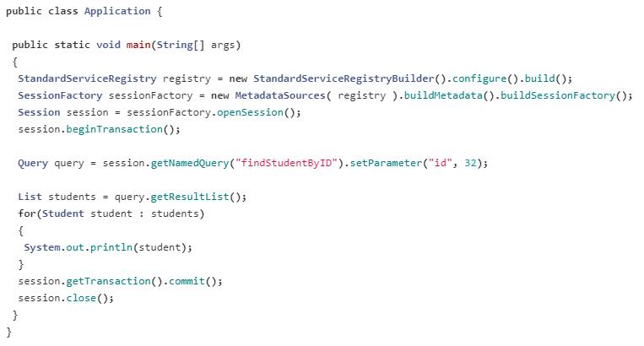
Named Queries

Slide 15
ACID Properties
A Transaction represents a single unit of work performed in sequence against the database. In other words, a transaction is a collection of read/write operations which succeeds only if all contained operations succeed.
A transaction has 4 properties termed as ACID Properties:
Atomicity
Consistency
Isolation
Durability

Slide 16
ACID Properties
Atomicity
Atomicity means that either all of the transactions will execute successfully or none of them will.
Consistency
Consistency means that constraints are enforced for every committed transaction. That indicates that all Keys, Data types, Checks, and Triggers are successful and no constraint violation is triggered.

Slide 17
ACID Properties
Isolation
If two transactions are executing concurrently and working on the same data, then one transaction should not disturb the other transaction. Isolation guarantees that concurrently running transactions should not affect each other.
Durability
Durability means that once a transaction is complete, it guarantees that all of the changes are recorded in the database. If our system is suddenly affected by a system crash or a power outage, then all unfinished committed transactions may be replayed.

